Slide 1
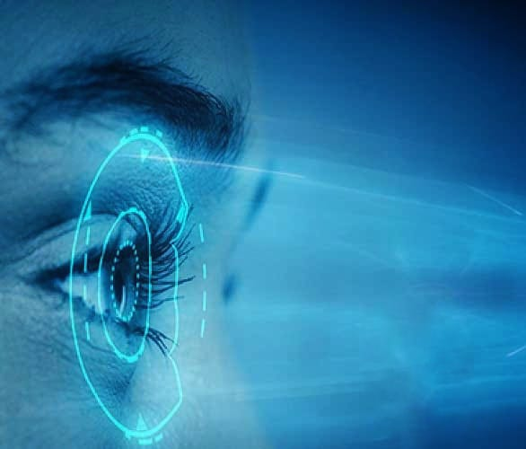
TEAM-3
IRIS TUMOR DETECTION USING CONVOLUTIONAL
NEUREAL NETWORK

Slide 2

PROJECT OVERVIEW
PROBLEM STATEMENT
Challenges:
Manual inspection of iris images is time-consuming and prone to human error.
Early tumor detection is crucial for improving treatment outcomes.
There is a need for automated systems that provide quick and accurate diagnosis.
Solutions:
USE CNN to automatically detect and classify tumors in iris images, saving time and improving accuracy.
INTRODUCTION:
Iris tumor detection is crucial for early diagnosis and
treatment of eye-related diseases.
CNN models are highly effective for classifying
medical images.
OBJECTIVES:
Develop a web-based platform for users to upload iris images.
Use CNN to detect and classify tumors.

Slide 3
TECHNOLOGY STACK
Frontend:
HTML, CSS, JavaScript: For creating the user interface.
Bootstrap: For responsive web design.
Backend:
Python (Django): For handling server-side logic.
TensorFlow: For training the CNN model.
Database:
MySQL/SQLite: To store user data and uploaded iris images.
Libraries:
OpenCV: For image preprocessing and feature extraction.
SYSTEM ARCHITECTURE
Overview:
Frontend: Login/Registration → Image Upload → Display Result.
Backend: Image Processing, CNN Model → Result Prediction.
Database: Stores user data (login, images, results).
Diagram:
A flowchart showing how the user interacts with the system:
User Uploads Image → CNN Model Processes Image → Result Displayed (Benign/Malignant)

Slide 4

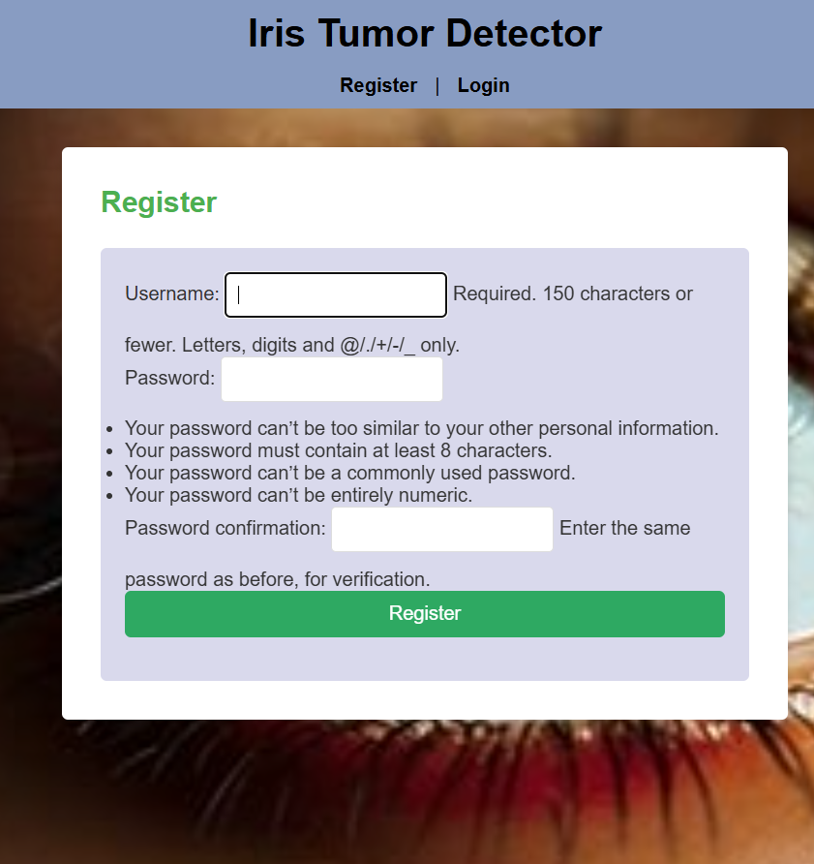
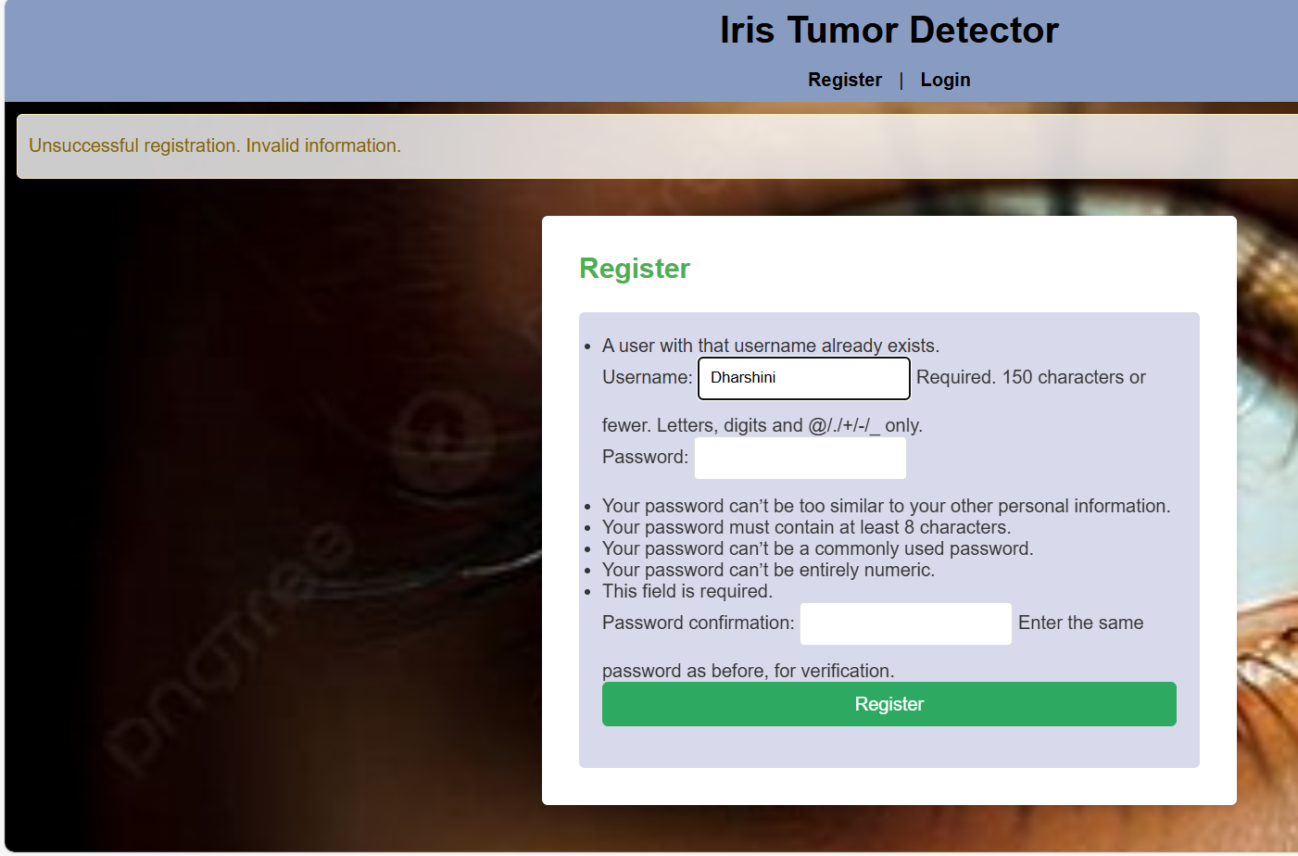
REGISTRATION PAGE
DESIGN:
Features:
Username, Password, Confirm Password fields.
Register Button to create an account.
Option to Login if the user already has an account.
Functionality:
Collect and store user information securely.
Input validation for username and password.

Slide 5
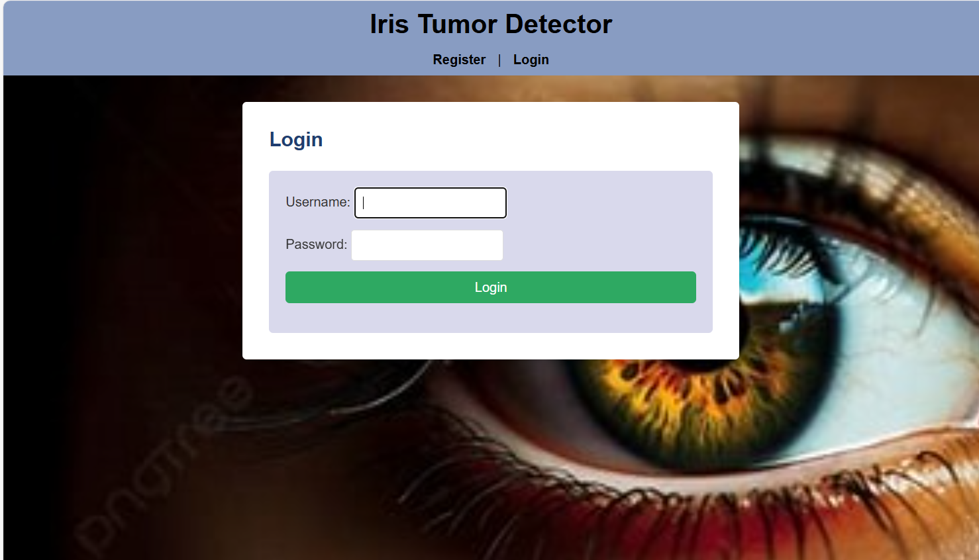
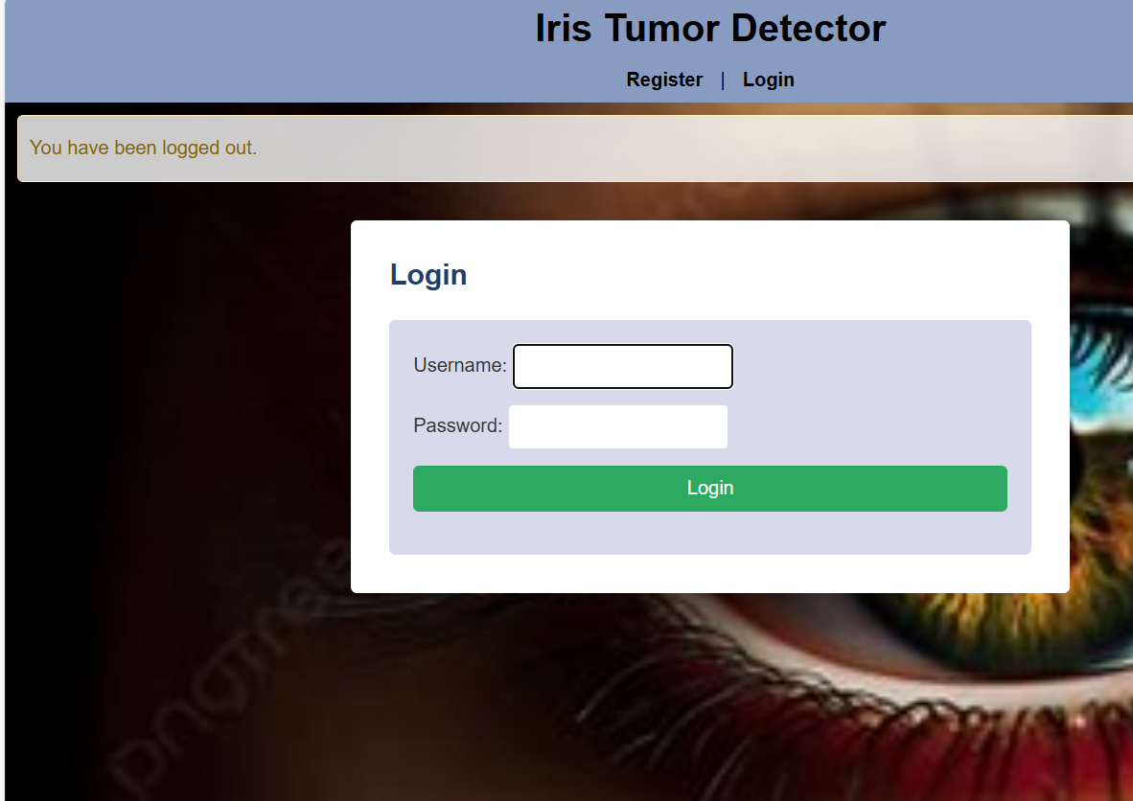
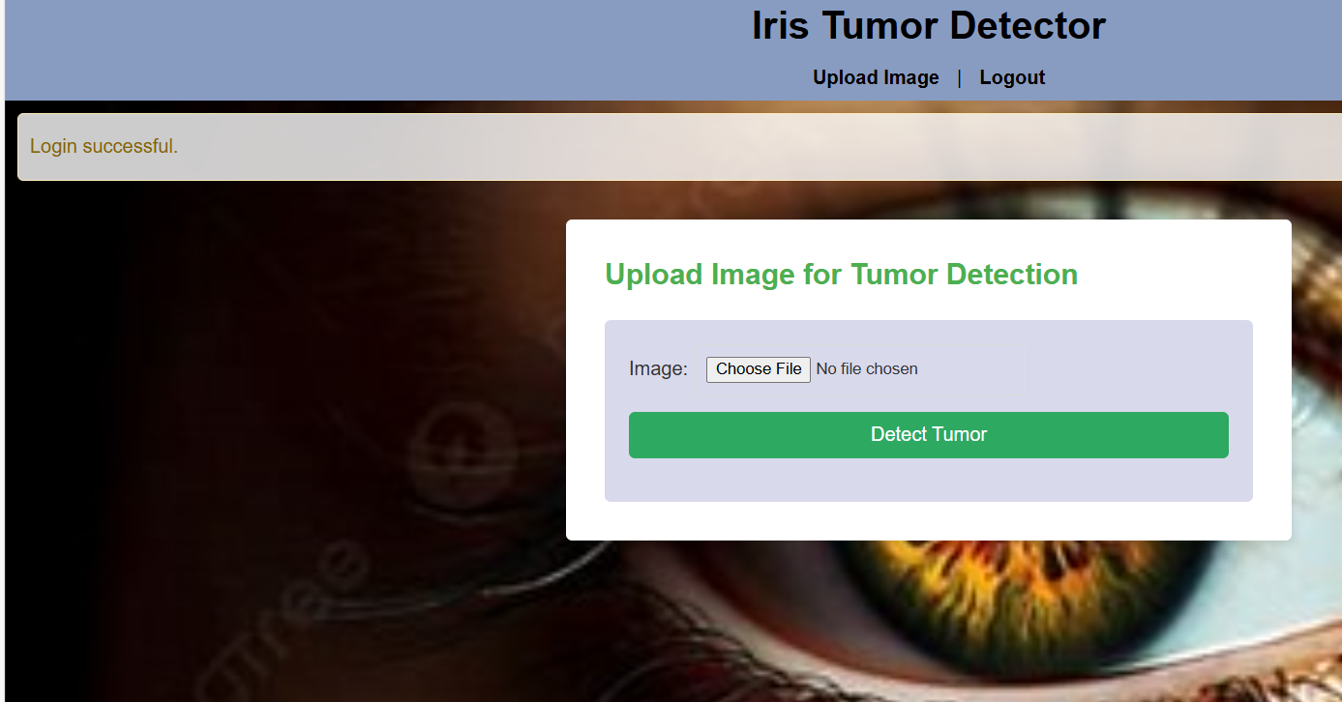
LOGIN PAGE DESIGN
Features:
Username and Password fields for user authentication.
Login Button to access the system.
Option to Sign Up (redirects to the Registration page).
Visuals:
A mockup or wireframe of the login page (simple, professional design with fields and buttons).

Slide 6
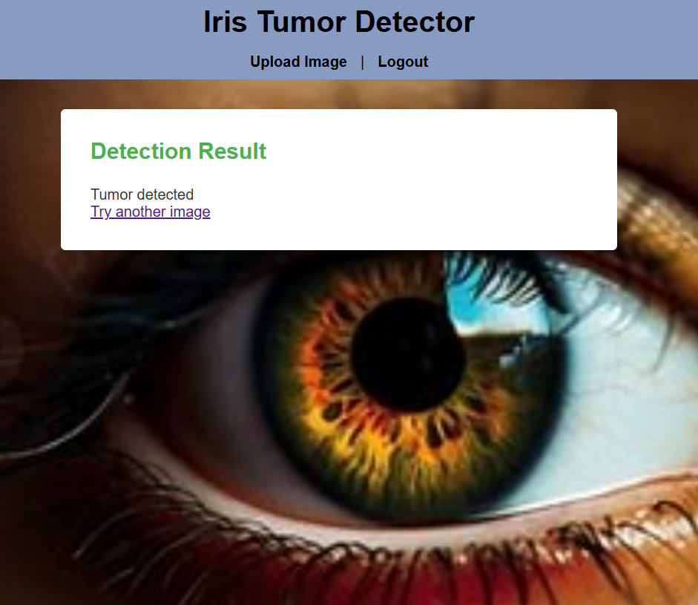
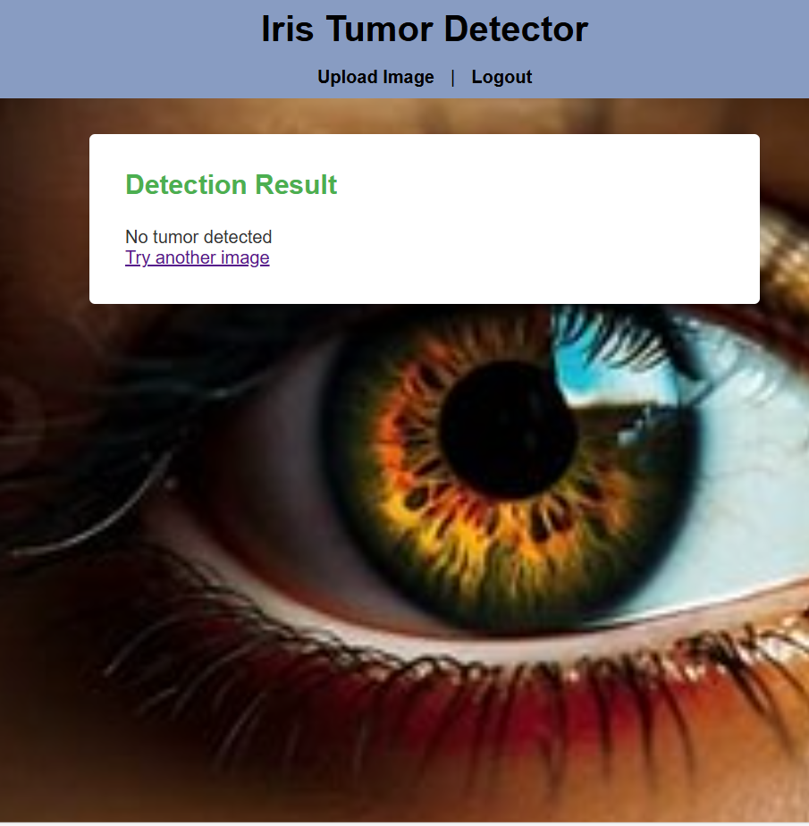
WEBPAGE FOR IRIS TUMOR DETECTION
Main Features:
Upload Image: A button for users to upload iris images.
Display Result: After the image is uploaded, the system classifies the tumor as benign or malignant and shows the result.
Visual Feedback: The result page includes the uploaded image with a visual highlight of the detected tumor.
Confidence Score: Displays the model's confidence in its classification.

Slide 7
CONCLUSION
The Iris Tumor Detection Using Convolutional Neural Networks(CNN) project demonstrates the potential of deep learning to automate and improve the accuracy of medical diagnoses, particularly in the detection of tumor within the iris. By combining advanced image processing techniques with the power of CNNs, this system provides a highly Efficient and reliable tool for early detection, which can be crucial for timely treatment and improving patient outcomes.

Slide 8
THANK YOU
Presented by:
M. Jayasri
K. Hariharan
C. M. Dharshini

